Slide 1
GEXTON EDUCATION
Summer Internship Program
Movie Success Prediction
Data Science Task #12 — Predictive Analytics & Business Insights
Prepared for Sir Muhammad Arham MH
Machine Learning • Classification • Streamlit Deployment

Slide 2
Agenda
1
Project Overview & Objective
2
Dataset Description
3
Exploratory Data Analysis
4
Model Development & Comparison
5
Feature Importance
6
Predictions on New Movies
7
Business Insights & Recommendations
8
Conclusion & Deliverables
Movie Success Prediction — Gexton Education Summer Internship
2

Slide 3
Project Overview
Build a machine learning model to predict whether a movie is likely to become a commercial success, based on genre, budget, runtime, cast popularity, release year, audience ratings, and related attributes.
Scope of Work
Data cleaning & EDA
Feature encoding
Model training & tuning
Feature importance
New-movie prediction
Business insights
Streamlit deployment
1,500
10
3
85.3%
Movies Analyzed
Genres Covered
Models Compared
Best F1-Score
Movie Success Prediction — Gexton Education Summer Internship
3

Slide 4
Dataset Description
1,500 movies × 17 attributes
Category | Features
Production | genre, budget_million, runtime_minutes, release_year
Talent | cast_popularity, director_popularity, director_tier
Distribution | studio_type, num_screens, marketing_spend_million
Reception | critic_score, social_media_buzz, audience_rating
Outcome | revenue_million, roi, is_success (target)
Success is defined as: revenue ≥ 2× budget AND audience rating ≥ 6.0 / 10
Note: audience_rating is excluded from model features to prevent target leakage, since it directly informed the success label.
Movie Success Prediction — Gexton Education Summer Internship
4

Slide 5
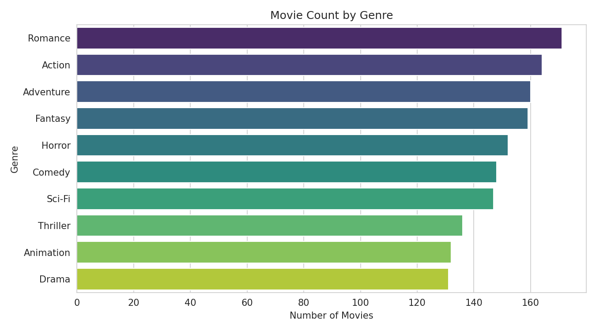
Exploratory Data Analysis
Genre distribution across the dataset
Movie Success Prediction — Gexton Education Summer Internship
5

Slide 6
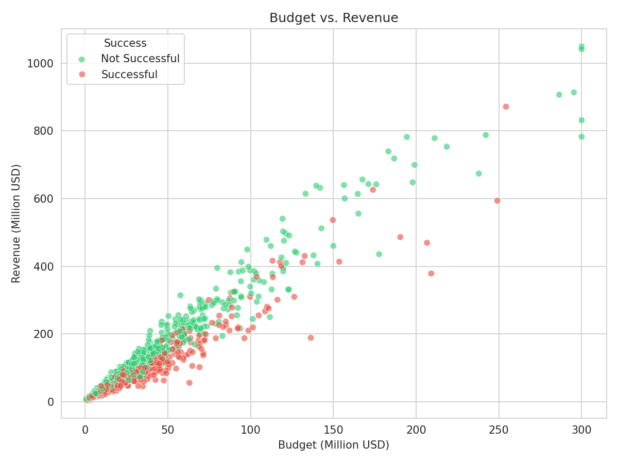
Budget vs. Revenue
Higher budgets trend toward higher revenue, but success is not guaranteed
Movie Success Prediction — Gexton Education Summer Internship
6

Slide 7
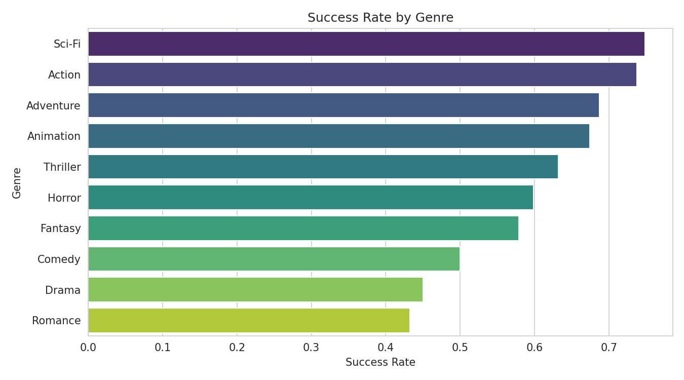
Success Rate by Genre
Animation, Action, and Sci-Fi lead in success rate
Movie Success Prediction — Gexton Education Summer Internship
7

Slide 8
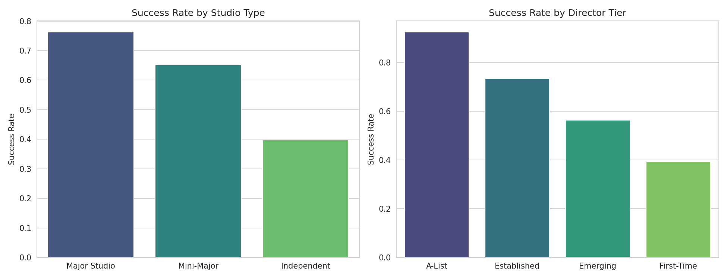
Studio & Director Effects on Success
Movie Success Prediction — Gexton Education Summer Internship
8

Slide 9
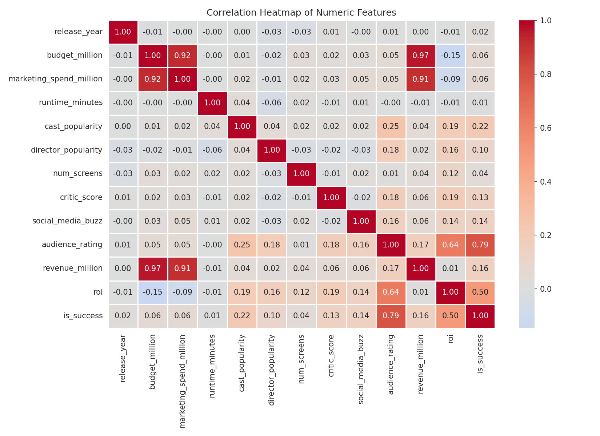
Correlation Analysis
Relationships between numeric features
Movie Success Prediction — Gexton Education Summer Internship
9

Slide 10
Machine Learning Approach
1
Data Split
80% train / 20% test, stratified by target class
2
Preprocessing
Standard scaling (numeric) + one-hot encoding (categorical) in a single pipeline
3
Model Training
Logistic Regression, Random Forest, Decision Tree
4
Hyperparameter Tuning
GridSearchCV with 5-fold cross-validation, optimizing F1-score
5
Model Selection
Best model chosen by highest F1-score on the test set
Movie Success Prediction — Gexton Education Summer Internship
10

Slide 11
Model Performance Comparison
Model | Accuracy | Precision | Recall | F1-Score
Logistic Regression | 82.0% | 84.0% | 86.7% | 85.3%
Random Forest | 78.3% | 77.9% | 89.5% | 83.3%
Decision Tree | 71.0% | 75.3% | 77.3% | 76.3%
Logistic Regression selected as the best-performing model based on F1-score.
Movie Success Prediction — Gexton Education Summer Internship
11

Slide 12
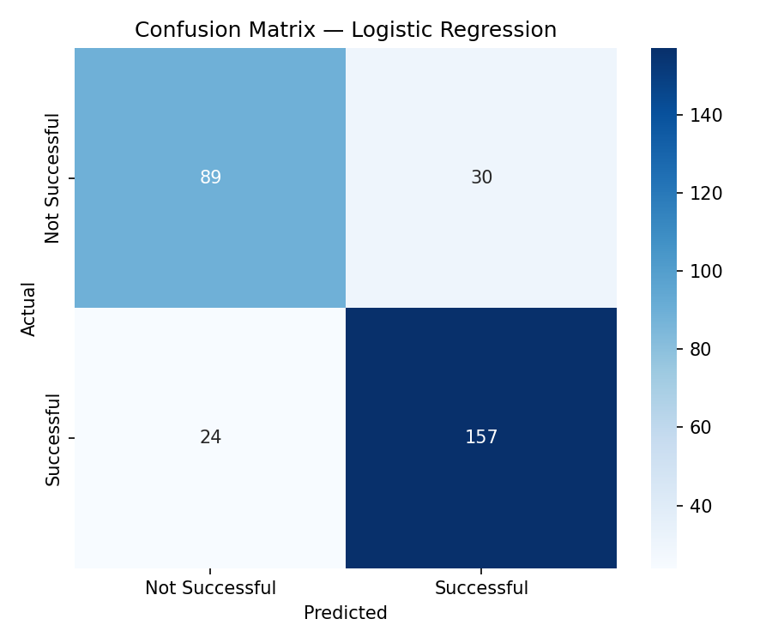
Confusion Matrix
Logistic Regression — best-performing model
Movie Success Prediction — Gexton Education Summer Internship
12

Slide 13
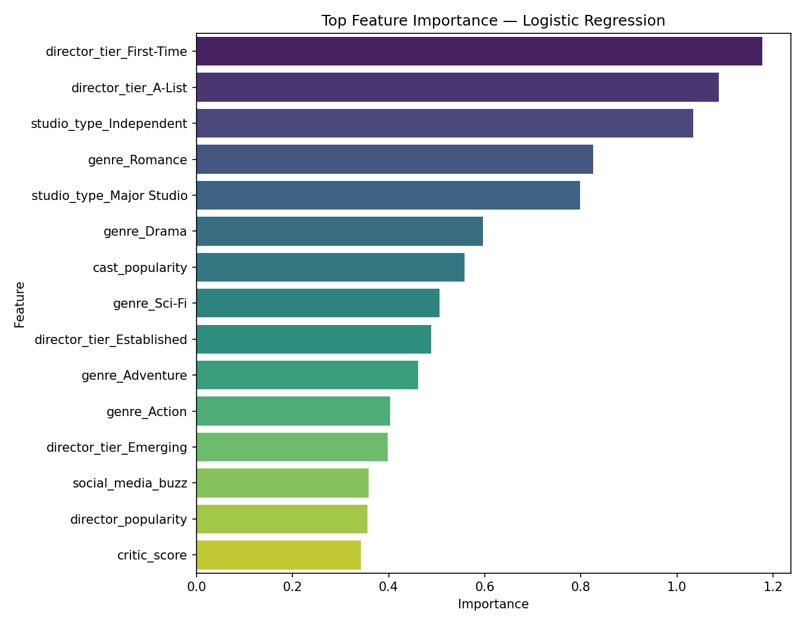
Feature Importance
Top factors driving predicted success
Movie Success Prediction — Gexton Education Summer Internship
13

Slide 14
Predictions on New Movie Concepts
Movie ID | Genre | Budget ($M) | Prediction | Probability
NEW-001 | Action | 120 | Successful | 99.6%
NEW-002 | Drama | 8 | Not Successful | 11.0%
NEW-003 | Animation | 95 | Successful | 98.3%
NEW-004 | Horror | 12 | Not Successful | 5.3%
NEW-005 | Sci-Fi | 180 | Successful | 99.9%
Movie Success Prediction — Gexton Education Summer Internship
14

Slide 15
Business Insights & Recommendations
Genre Strategy
Talent & Studio
Prioritize Animation, Action, and Sci-Fi for high-budget investment.
A-List directors and Major Studio backing measurably lift success rates.
Distribution
Marketing
Wider screen counts correlate positively with success — negotiate strong commitments.
Scale marketing spend proportionally with production budget.
Early Signals
Independents
Monitor critic score and social media buzz as leading indicators pre-release.
Smaller studios should lean on strong critic scores and buzz to offset budget gaps.
Movie Success Prediction — Gexton Education Summer Internship
15

Slide 16
Conclusion
This project delivers a complete, reproducible machine learning workflow — from data preparation through model deployment — that predicts movie commercial success and provides actionable insights for producers and studios.
✓ Cleaned dataset & saved model (.pkl)
✓ Prediction results on new records
✓ Business insights & recommendations
✓ Final report (Word) & presentation (PPT)
✓ Interactive Streamlit application
✓ GitHub-ready repository with documentation
Thank you

